Slide 1


Business Intelligence Machine Learning

Slide 2


Project Summary
This project has been conducted to analyse the employee's salary, benefits, and compensation in various job industries in San Francisco. Pre-processing, modelling, and visualization are included to draw insights from the dataset.

Slide 3
Employee Compensation
Description:
This dataset is form the San Francisco Controller's Office that maintains a database of the salary and benefits paid to City employees since fiscal year 2013.
Data Source:
DATA.GOV - https://catalog.data.gov/dataset/employee-compensation
Data Size:
Total no of columns/features/variable : 22
Total no of rows/records/observation : 758605

Slide 4
Dataset Variables
1 - Organization Group Code
2 - Job Family Code
3 - Job Code
4 - Year Type
5 - Year
6 - Organization Group
7 - Department Code
8 - Department
9 - Union Code
10 - Union
11 - Job Family
12 - Job
13 - Employee Identifier
14 - Salaries
15 - Overtime
16 - Other Salaries
17 - Total Salary
18 - Retirement
19 - Health and Dental
20 - Other Benefits
21 - Total Benefits
22 - Total Compensation

Slide 5


Models & Techniques
Missing Value Ratio
Variance Filter
High Correlation Filter
Multilinear Regression
Logistic Regression
Polynomial Regression
Decision Tree
Random Forest
Jupyter Notebook
Power BI

Slide 6
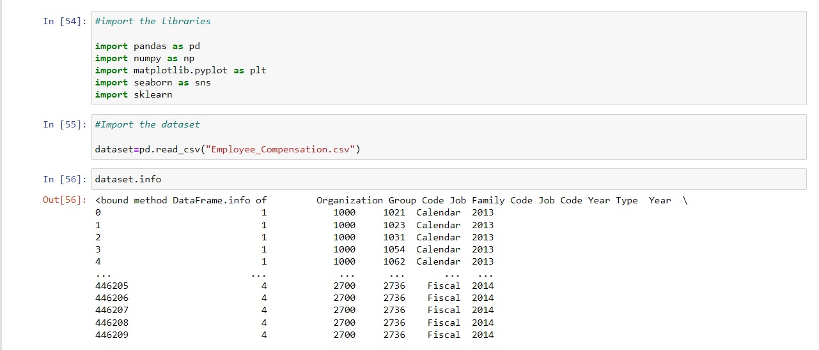
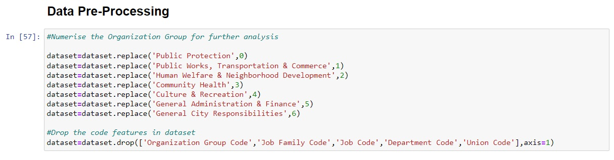
Pre-Processing Techniques

Slide 7
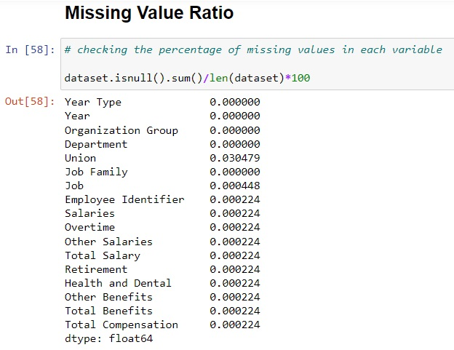
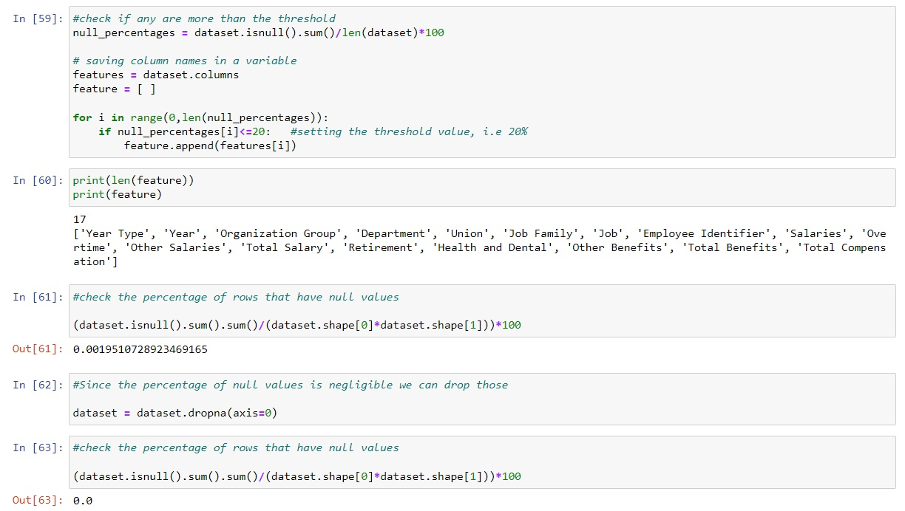
Dimensionality Reduction Techniques

Slide 8
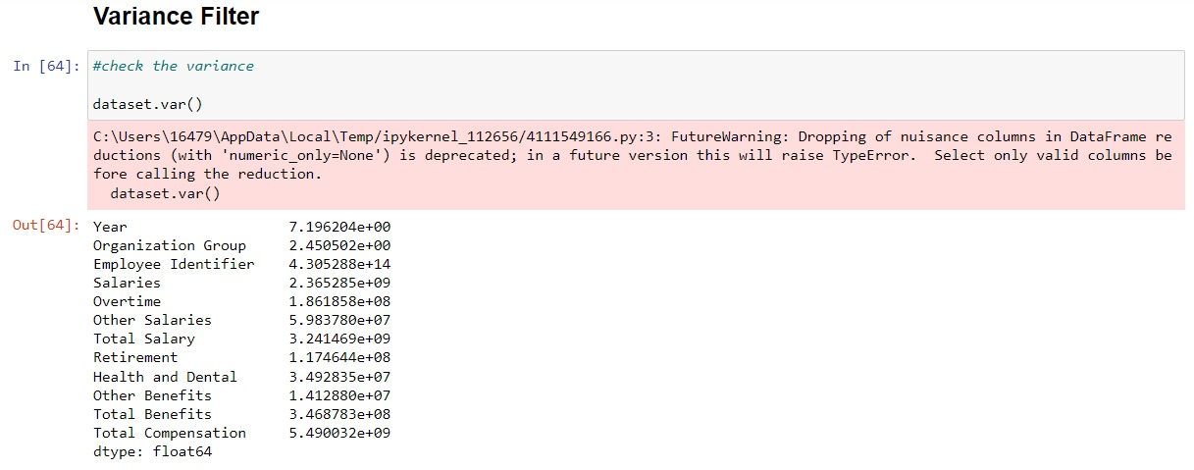
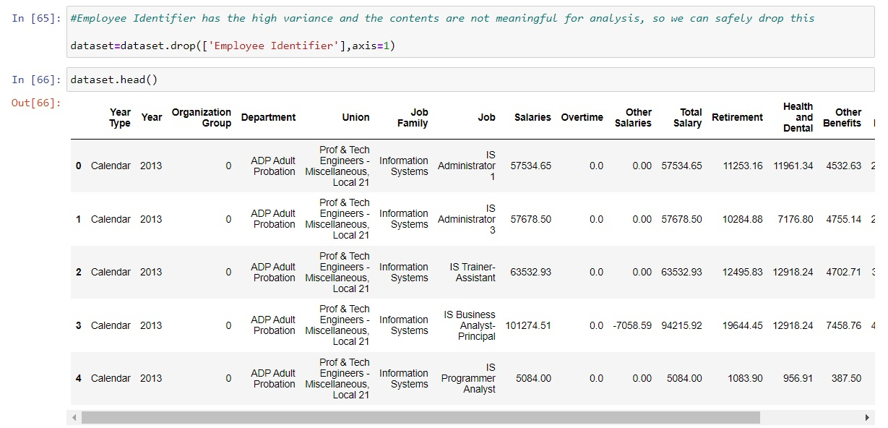
Dimensionality Reduction Techniques

Slide 9
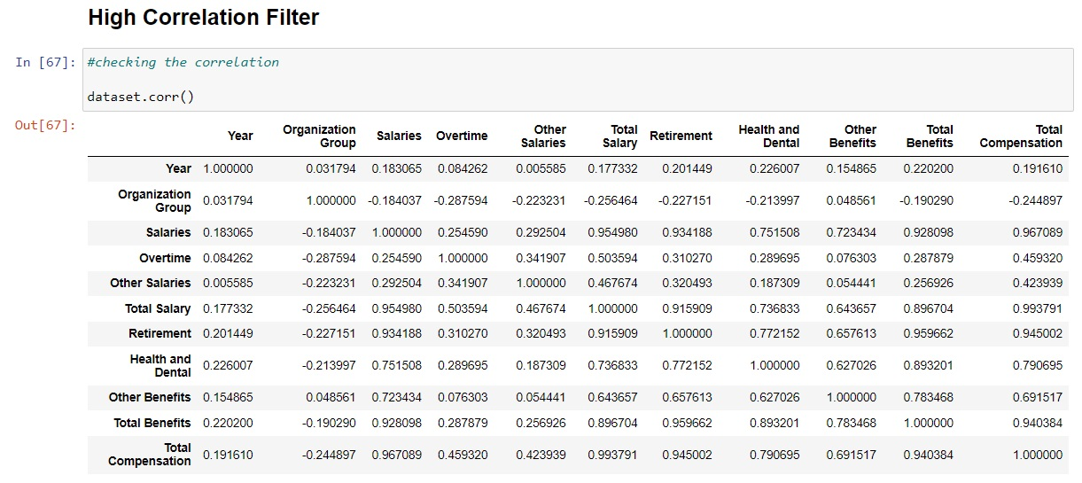
Dimensionality Reduction Techniques

Slide 10
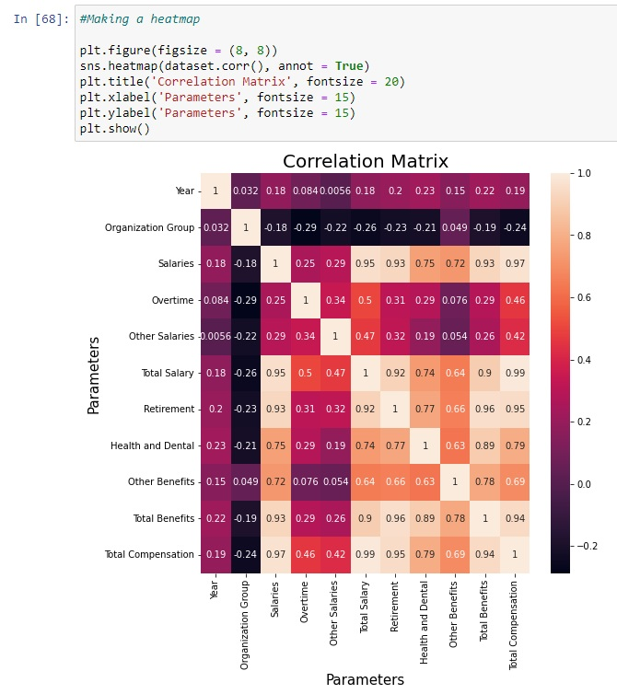
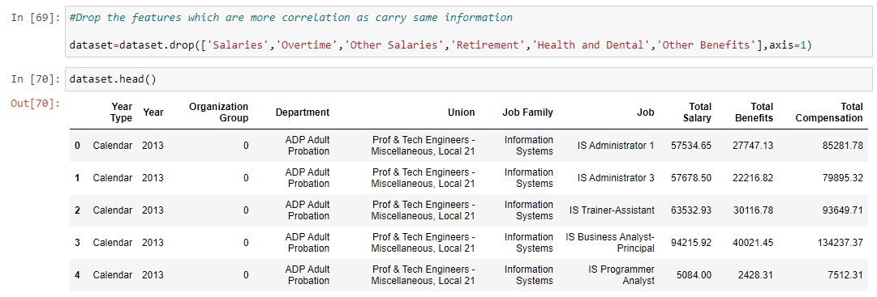
Dimensionality Reduction Techniques
22 Variables > 10 Variables
Most significant columns:
Organization Group
Total Salary
Total Benefits
Total Compensation

Slide 11
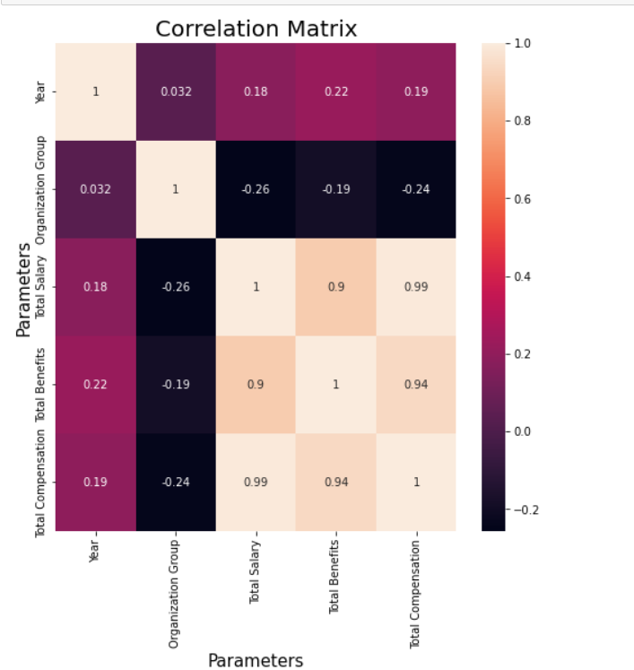
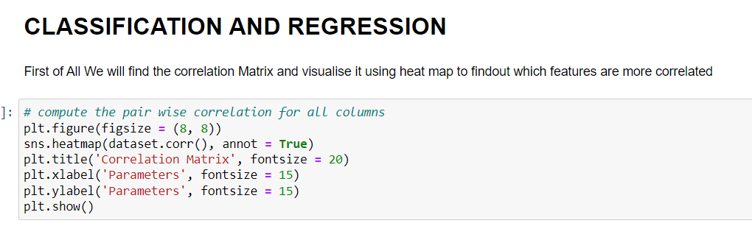
Classification and Regression Techniques

Slide 12
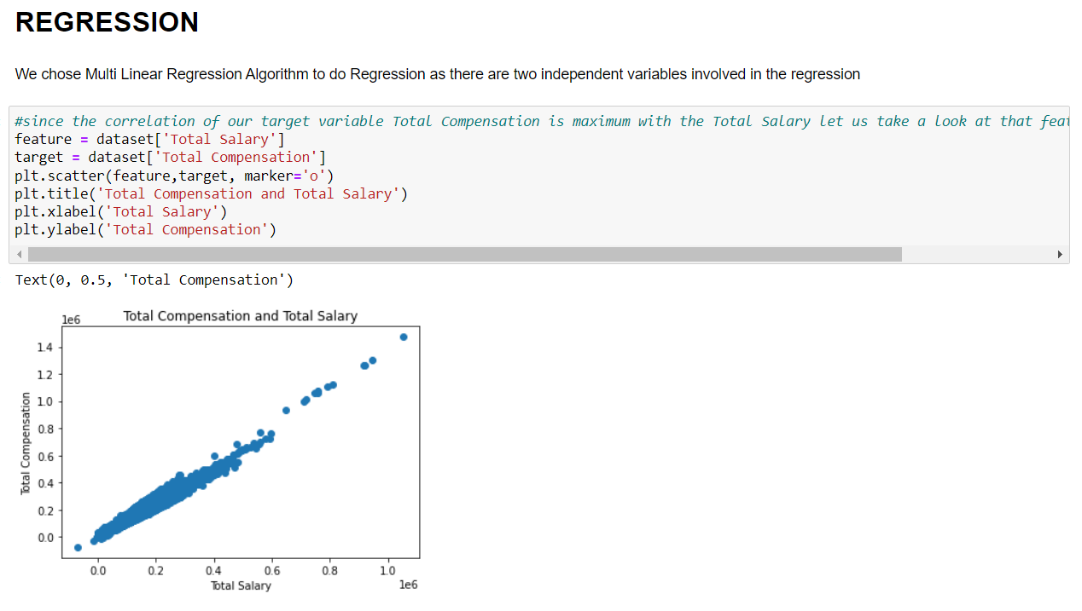
Multi Linear Regression

Slide 13
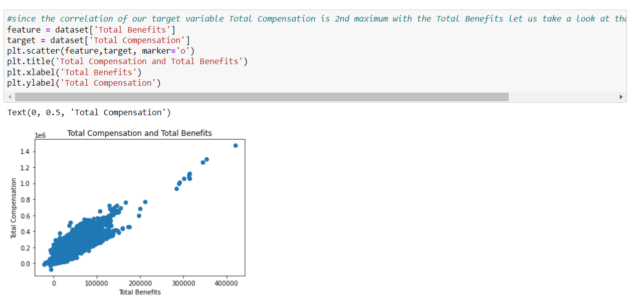
Multi Linear Regression

Slide 14
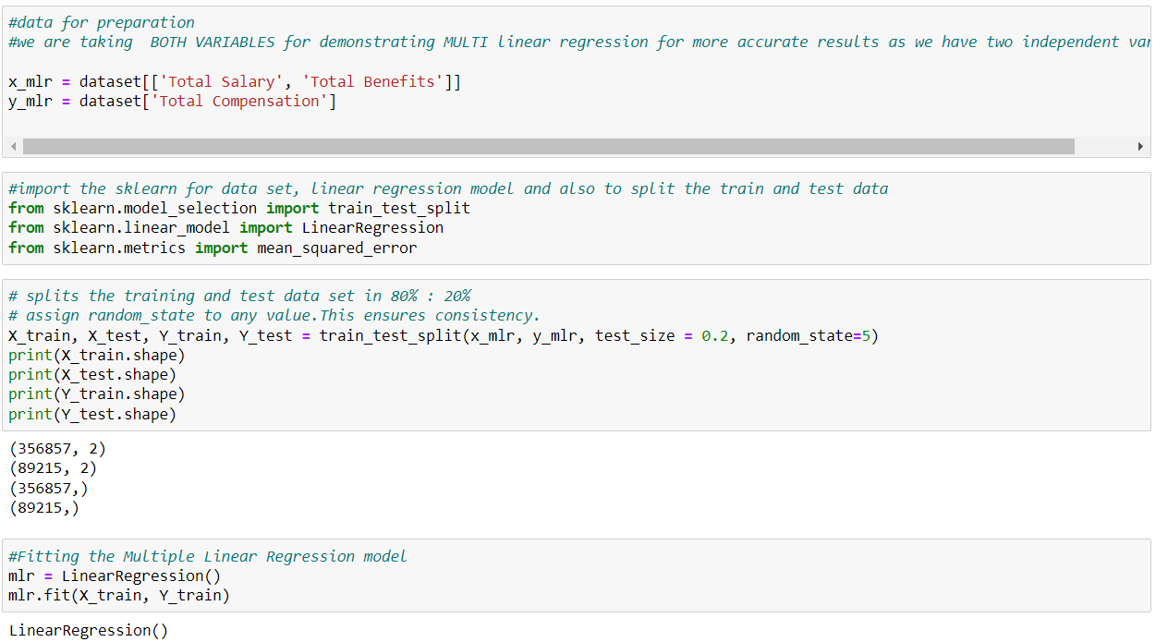
Multi Linear Regression

Slide 15
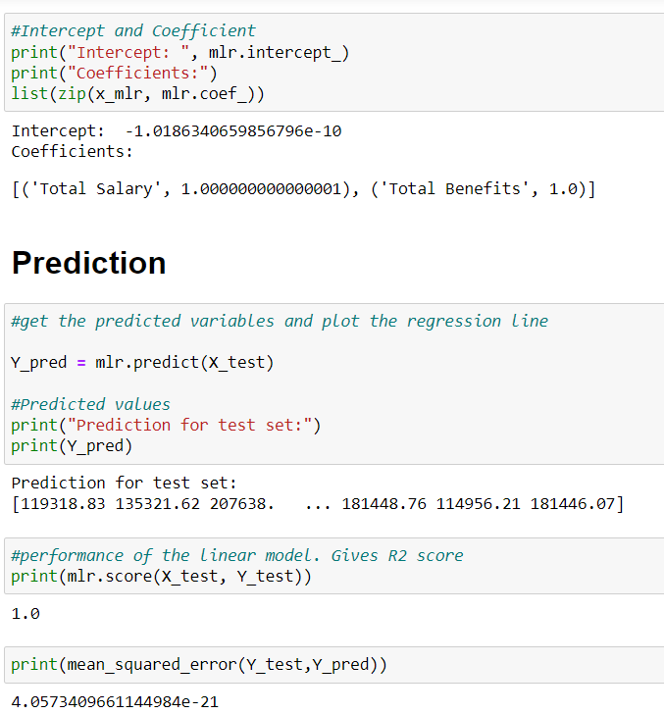
Multi Linear Regression

Slide 16
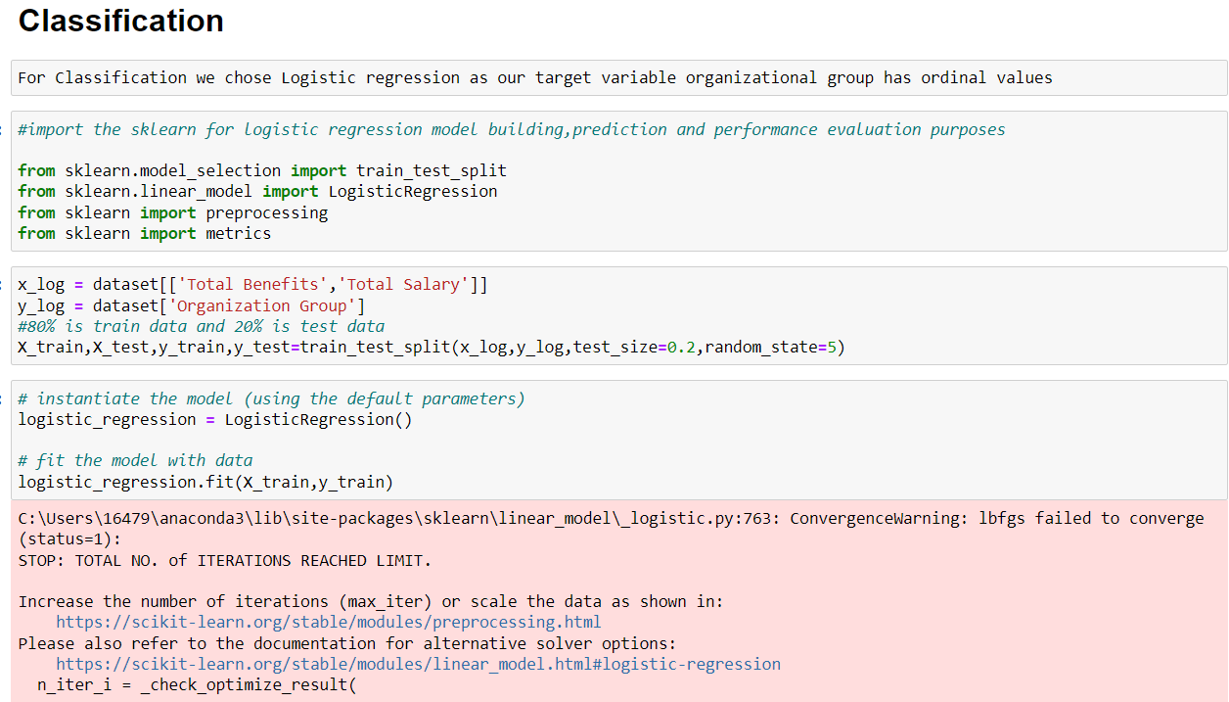
Logistic Regression

Slide 17
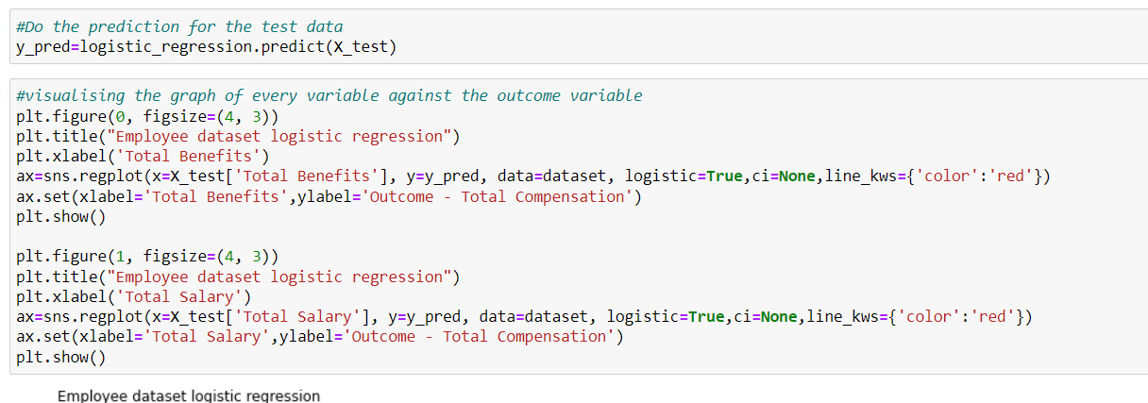
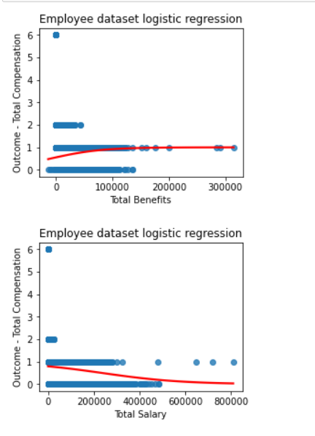

Logistic Regression

Slide 18
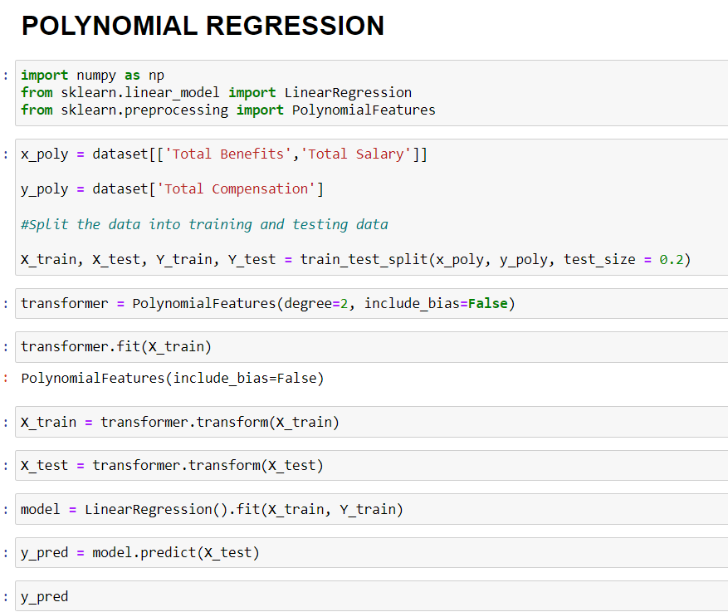
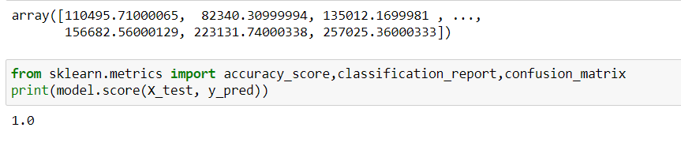
Polynomial Regression

Slide 19
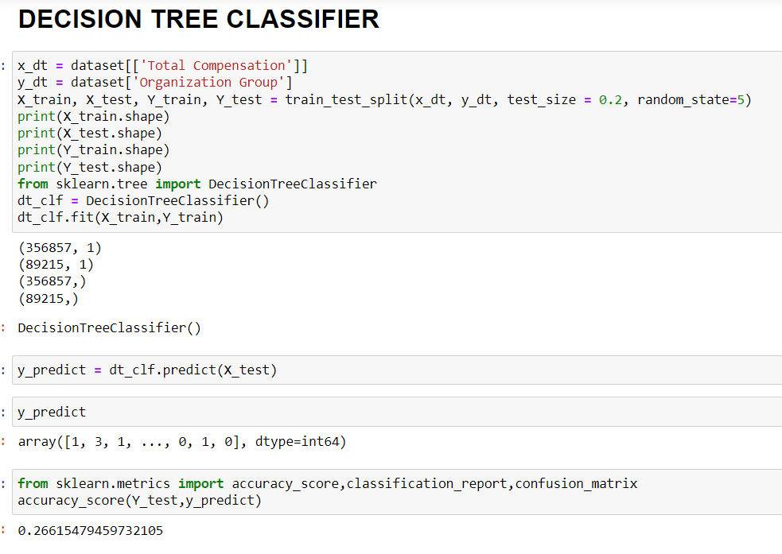
Decision Tree Classifier

Slide 20
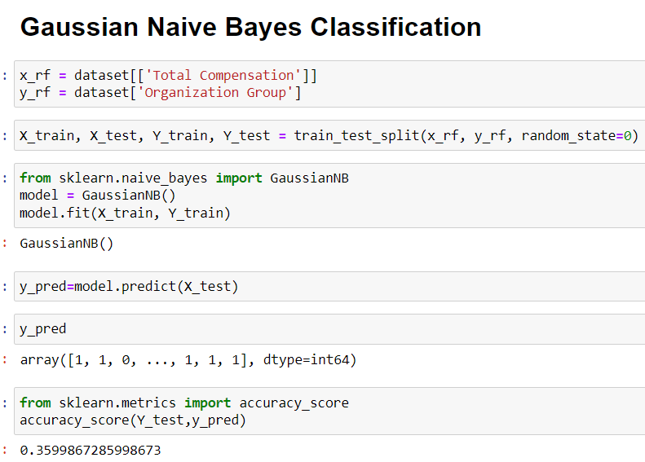
Gaussian Naïve Bayes Classification

Slide 21
Interpretation
From the above analysis of classification and regression techniques we found that for regression multi linear regression has highest accuracy as the dependent variable is linearly dependent on the two independent variables and for classification Logistic regression has highest accuracy as it classifies the target variable accurately using 80% train data

Slide 22
Dataset Exploring Questions
What are the top 10 departments based on average salaries of employees?
What are the top 10 jobs based on average salary?
What are the 10 departments with the lowest average compensation and salaries?
Which organization group have the most benefits?
Which organization group is offering high overtime as compared to others?

Slide 23
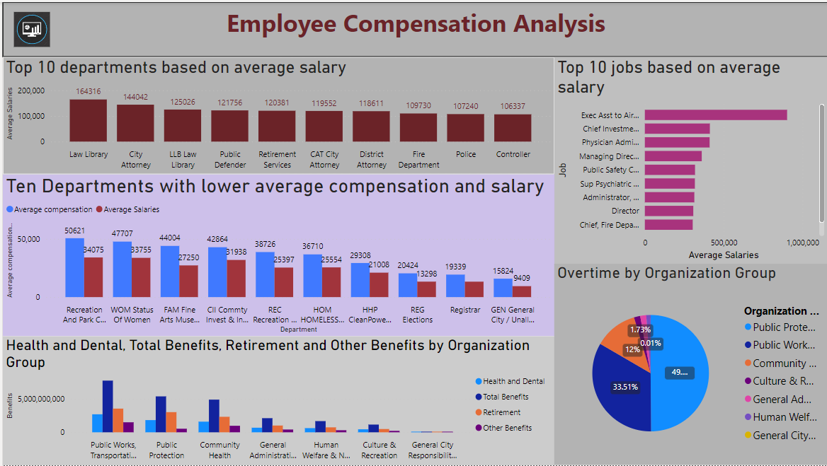

Slide 24
Conclusion
The average salary for employees who belong to a law library department is higher as compared to the other departments.
Public protection provides nearly 50% of the overall overtime to employees as compared to other groups. while general city responsibilities provide fewer benefits to employees.
An executive assistant to the airport director is the topmost job with a higher average salary.

Slide 25

Thank You

